Slide 1

CSE- 321
Software Engineering
Chapter : 04 Software Processes (cont.)
Fahad Ahmed
Lecturer, Dept. of CSE
E-mail: fahadahmed@uap-bd.edu

Slide 2
Lecture Outlines
Waterfall Model
Rapid application development model (RAD)
Spiral Model
Incremental Model
V-Model
Agile Model
Big bang model
Prototype Model
Comparison of Various SDLC Models

Slide 3
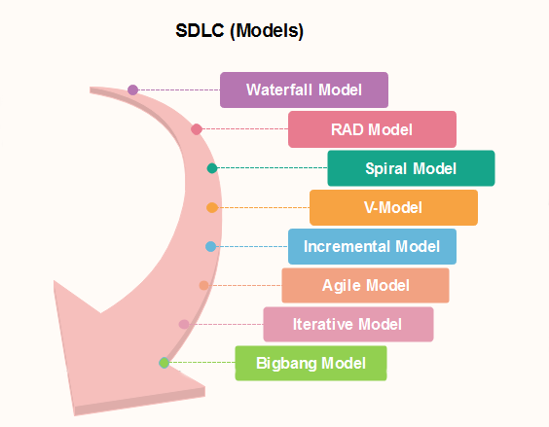
Popular SDLC models

Slide 4
Waterfall Model
What is The Waterfall Model? (Iterative)
Also called classic software life cycle or sequential model or linear-sequential life cycle model
Process activities (phases/stages) are clearly separated
After a number of iterations, phases of the life cycle (such as specification and design) are “frozen”
It was introduced in 1970 by Winston Royce.

Slide 5
Waterfall Model
When to use SDLC Waterfall Model
Waterfall model can be used when
Requirements are not changing frequently
Can be used also for parts of larger software systems
Requirement is clear
Environment is stable
Technology and tools used are not dynamic and is stable
Resources are available and trained
Drawback of the waterfall model
Difficult to incorporate change requests.
Incremental delivery not supported.
Overlapping of phases not supported.
Risk handling not supported.
Limited customer interactions.

Slide 6
Rapid application development model (RAD)
Rapid application development model (RAD) is a linear sequential software development process model that emphasizes a concise development cycle using an element based construction approach.
Rapid Application Development process is an adoption of the waterfall model, it targets at developing software in a short span of time.
RAD model has following phases
Business Modeling
Data Modeling
Process Modeling
Application Generation
Testing and Turnover
https://www.guru99.com/what-is-rad-rapid-software-development-model-advantages-disadvantages.html

Slide 7
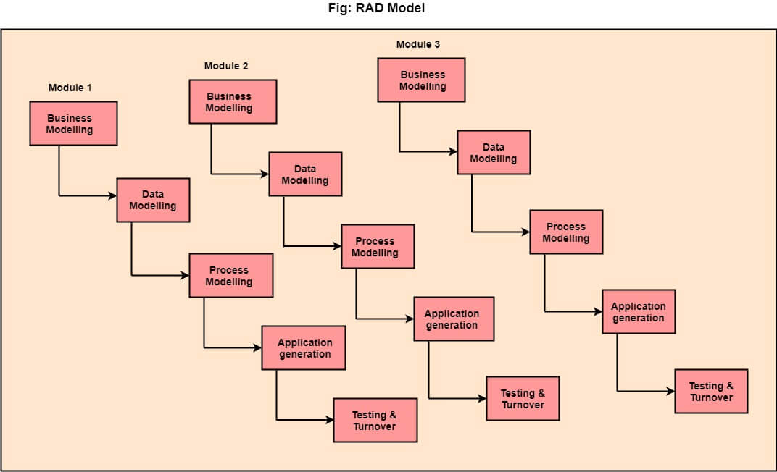
Rapid application development model (RAD)
https://www.javatpoint.com/software-engineering-rapid-application-development-model

Slide 8
Rapid application development model (RAD)
When to use RAD Model?
When the system should need to create the project that modularizes in a short span time (2-3 months).
It is also suitable for projects where requirements can be modularized and reusable components are also available for development.
The model can also be used when already existing system components can be used in developing a new system with minimum changes.
This model can only be used if the teams consist of domain experts. This is because relevant knowledge and ability to use powerful techniques is a necessity.
The model should be chosen when the budget permits the use of automated tools and techniques required.

Slide 9
Rapid application development model (RAD)
Advantage of RAD Model
Use of reusable components helps to reduce the cycle time of the project.
Feedback from the customer is available at initial stages.
Reduced costs as fewer developers are required.
Use of powerful development tools results in better quality products in comparatively shorter time spans.
The progress and development of the project can be measured through the various stages.
It is easier to accommodate changing requirements due to the short iteration time spans.
Disadvantage of RAD Model
It required highly skilled designers.
All application is not compatible with RAD.
For smaller projects, we cannot use the RAD model.
On the high technical risk, it's not suitable.
Required user involvement.

Slide 10
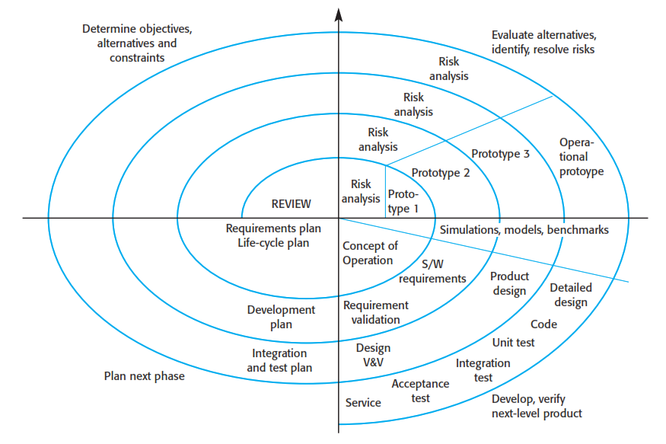
Spiral Model

Slide 11
Spiral Model Sectors
Objective setting
Specific objectives for the phase are identified.
Risk assessment and reduction
Risks are assessed and activities put in place to reduce the key risks.
Development and validation
A development model for the system is chosen which can be any of the generic models.
Planning
The project is reviewed and the next phase of the spiral is planned.
Why Spiral Model is called Meta Model ?
The Spiral model is called as a Meta Model because it subsumes all the other SDLC models.

Slide 12
Spiral Model
https://www.javatpoint.com/software-engineering-spiral-model
When to use Spiral Model?
When deliverance is required to be frequent.
When the project is large
When requirements are unclear and complex
When changes may require at any time
Large and high budget projects
Advantages
Risk Handling
Good for large projects
Flexibility in Requirements
Customer Satisfaction
Disadvantages
Complex
Expensive
Too much dependable on Risk Analysis
Difficulty in time management

Slide 13
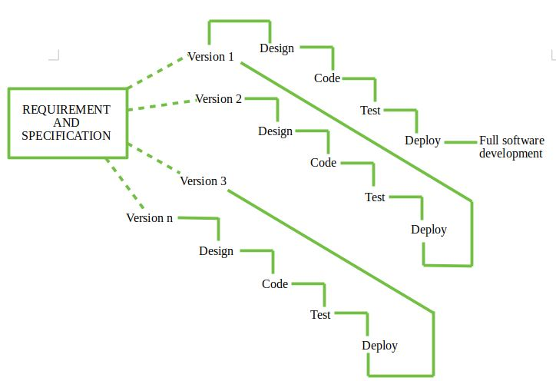
Incremental Model
Incremental process model is also know as Successive version model.
First, a simple working system implementing only a few basic features is built and then that is delivered to the customer. Then thereafter many successive iterations/ versions are implemented and delivered to the customer until the desired system is released.

Slide 14
Incremental Model
When we use the Incremental Model?
Funding Schedule, Risk, Program Complexity, or need for early realization of benefits.
When Requirements are known up-front.
When Projects having lengthy developments schedules.
Projects with new Technology.
Advantage
Errors are easy to be recognized.
Easier to test and debug
More flexible.
Simple to manage risk because it handled during its iteration.
The Client gets important functionality early.
Disadvantage
Need for good planning
Total Cost is high.
Well defined module interfaces are needed.

Slide 15
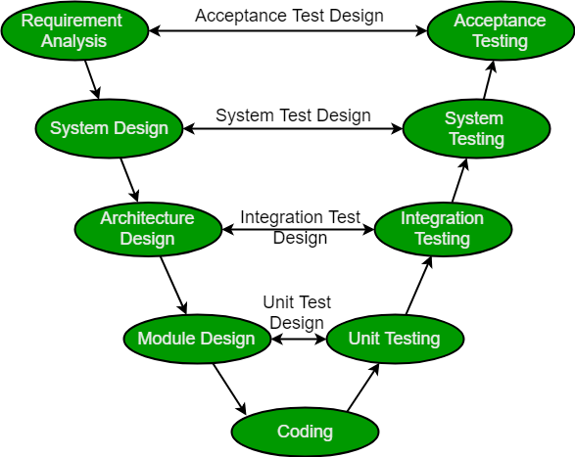
V-Model

Slide 16
V-Model
The left side of the model is Software Development Life Cycle - SDLC
The right side of the model is Software Test Life Cycle - STLC
The entire figure looks like a V, hence the name V – model
V-Model referred to as the Verification and Validation Model.
Process executes in a sequential manner in V-shape.
It is based on the association of a testing phase for each corresponding development stage. Development of each step directly associated with the testing phase.
The next phase starts only after completion of the previous phase.

Slide 17
V-Model
Design Phase:
Requirement Analysis
System Design
Architectural Design
Module Design
Testing Phases
Unit Testing
Integration testing
System Testing
User Acceptance Testing (UAT)

Slide 18
V-Model
Principles of V-Model:
Large to Small
Data/Process Integrity
Scalability
Cross Referencing
Tangible Documentation
When to use?
Where requirements are clearly defined and fixed.
The V-Model is used when ample technical resources are available with technical expertise.
Proactive defect tracking – that is defects are found at early stage.

Slide 19
V-Model
Advantages:
V-Model is used for small projects where project requirements are clear.
Simple and easy to understand and use.
Probability of building an error-free and good quality product.
Disadvantages:
It is not a good for complex and object-oriented projects.
It is not suitable for projects where requirements are not clear and contains high risk of changing.
It does not easily handle concurrent events.

Slide 20
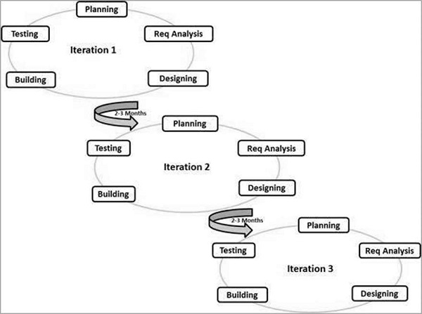
Agile Model
Agile SDLC model is a combination of iterative and incremental process models with focus on process adaptability and customer satisfaction by rapid delivery of working software product.

Slide 21
Agile Model
The agile software development emphasizes on four core values.
Individuals and interactions over processes and tools.
Working software over comprehensive documentation.
Customer collaboration over contract negotiation.
Responding to change over following a plan.

Slide 22
Agile Model
Principles of Agile model:
Our highest priority is to satisfy the customer through early and continuous delivery of valuable software.
Welcome changing requirements, even late in development. Agile processes harness change for the customer's competitive advantage.
Deliver working software frequently, from a couple of weeks to a couple of months, with a preference to the shorter timescale.
Business people and developers must work together daily throughout the project.
Build projects around motivated individuals. Give them the environment and support they need, and trust them to get the job done.
The most efficient and effective method of conveying information to and within a development team is face–to–face conversation.

Slide 23
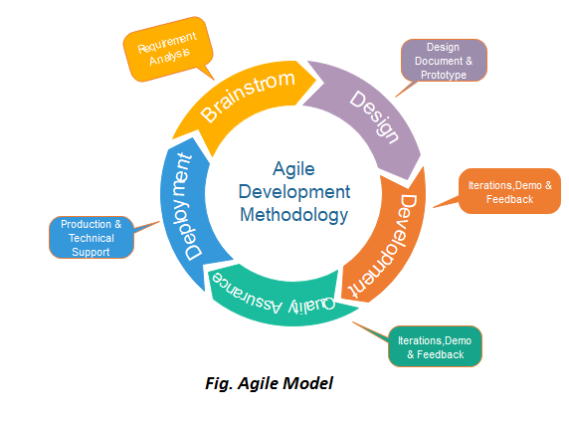
Agile Model
Phases of Agile Model:
Following are the phases in the Agile model are as follows:
Requirements gathering
Design the requirements
Construction/ iteration
Testing/ Quality assurance
Deployment
Feedback

Slide 24
Agile Model
Agile Testing Methods:
Scrum
Crystal
Dynamic Software Development Method(DSDM)
Feature Driven Development(FDD)
Lean Software Development
eXtreme Programming(XP)
For details: https://www.guru99.com/agile-scrum-extreme-testing.html

Slide 25
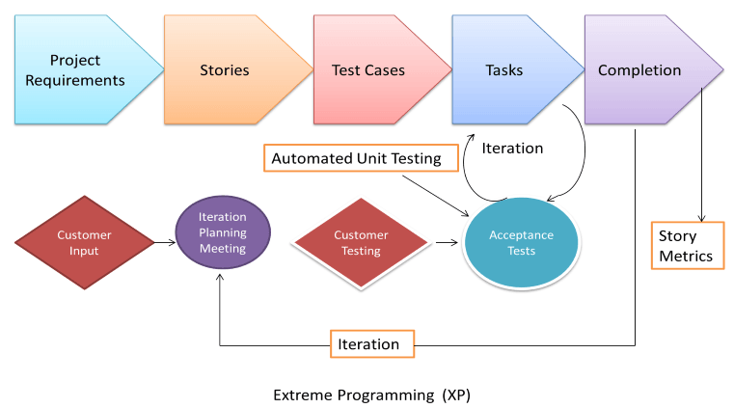
eXtreme Programming (XP)
eXtreme Programming (XP):
Extreme Programming technique is very helpful when there is constantly changing demands or requirements from the customers or when they are not sure about the functionality of the system. It advocates frequent "releases" of the product in short development cycles, which inherently improves the productivity of the system and also introduces a checkpoint where any customer requirements can be easily implemented. The XP develops software keeping customer in the target.

Slide 26
Agile Model
When to use the Agile Model?
When frequent changes are required.
When a highly qualified and experienced team is available.
When a customer is ready to have a meeting with a software team all the time.
When project size is small.
Advantage :
Frequent Delivery
Face-to-Face Communication with clients.
Efficient design and fulfils the business requirement.
Anytime changes are acceptable.
It reduces total development time.
Disadvantages :
Depends heavily on customer interaction, so if customer is not clear, team can be driven in the wrong direction.
There is a very high individual dependency, since there is minimum documentation generated.
Transfer of technology to new team members may be quite challenging due to lack of documentation.

Slide 27
Difference between Agile and Waterfall Model
Key Difference
Waterfall is a Liner Sequential Life Cycle Model whereas Agile is a continuous iteration of development and testing in the software development process.
Agile methodology is known for its flexibility whereas Waterfall is a structured software development methodology.
Agile follows an incremental approach whereas the Waterfall methodology is a sequential design process.
Agile performs testing concurrently with software development whereas in Waterfall methodology testing comes after the “Build” phase.
Agile allows changes in project development requirement whereas Waterfall has no scope of changing the requirements once the project development starts.

Slide 28
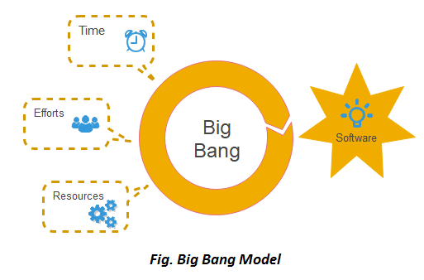
Big Bang Model
When to use Big Bang Model?
this model is required when this project is small like an academic project or a practical project. This method is also used when the size of the developer team is small and when requirements are not defined, and the release date is not confirmed or given by the customer.
Advantages:
There is no planning required.
Simple Model.
Few resources required.
Easy to manage.
Flexible for developers.

Slide 29
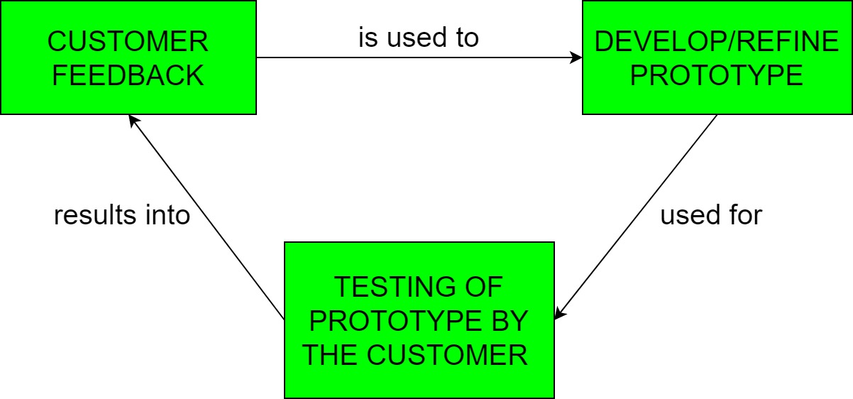
Prototyping Model
In Software Engineering, Prototype methodology is a software development model in which a prototype is built, test and then reworked when needed until an acceptable prototype is achieved.
Regular meetings are essential to keep the project on time and avoid costly delays in prototyping approach.
Missing functionality can be identified
Prototyping may encourage excessive change requests.

Slide 30
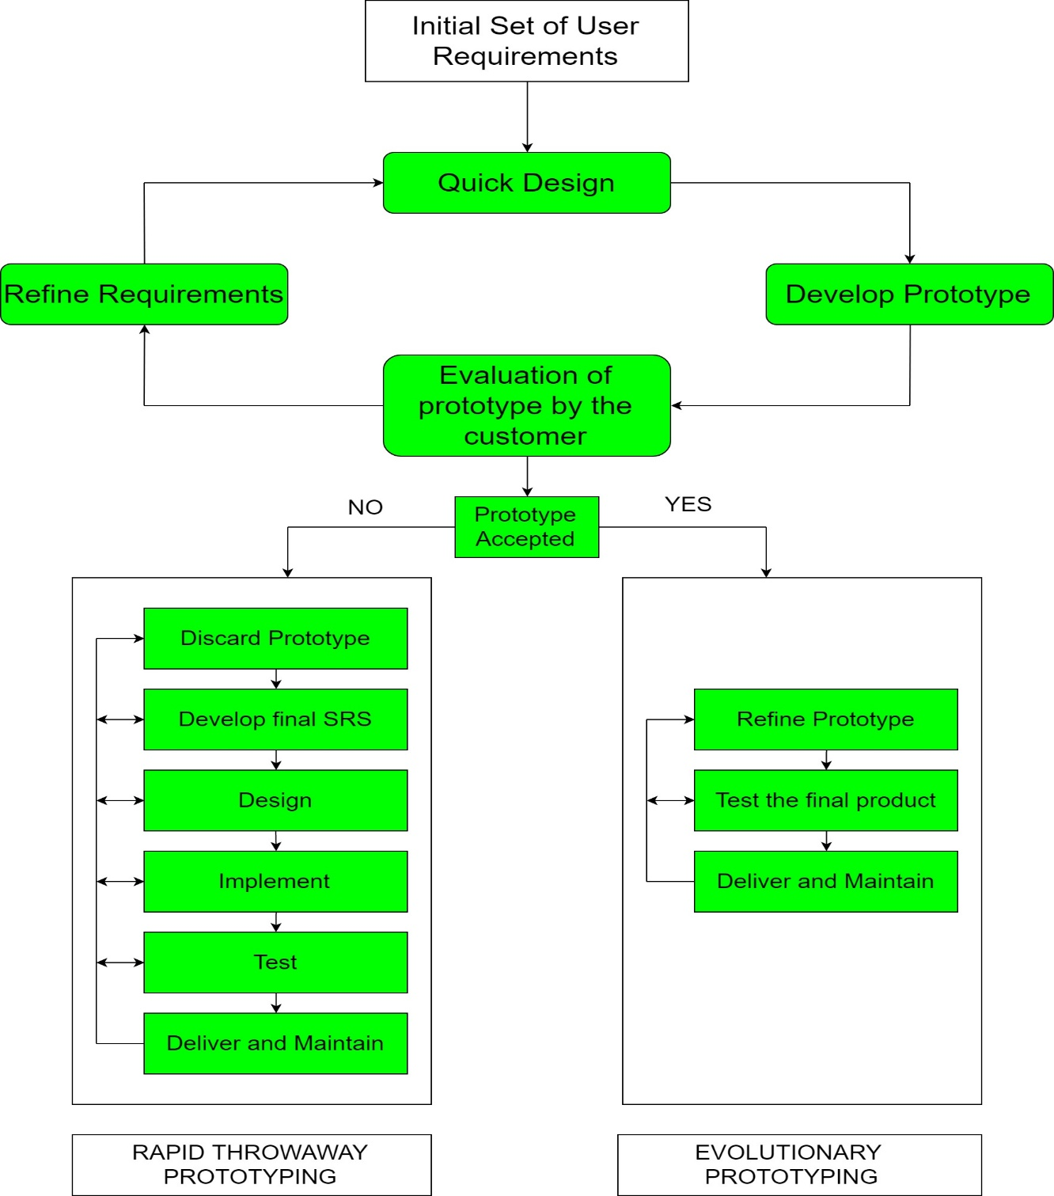
Prototyping Model
There are 2 approaches for this model:
Rapid Throwaway Prototyping
Evolutionary Prototyping

Slide 31
Prototyping Model
When to use
The Prototyping Model should be used when the requirements of the product are not clearly understood or are unstable. It can also be used if requirements are changing quickly. This model can be successfully used for developing user interfaces, high technology software-intensive systems, and systems with complex algorithms and interfaces. It is also a very good choice to demonstrate the technical feasibility of the product.

Slide 32
Prototyping Model
Advantage of Prototype Model
Reduce the risk of incorrect user requirement
Good where requirement are changing/uncommitted
Regular visible process aids management
Support early product marketing
Reduce Maintenance cost.
Errors can be detected much earlier as the system is made side by side.
Disadvantage of Prototype Model
An unstable/badly implemented prototype often becomes the final product.
Require extensive customer collaboration
Difficult to know how long the project will last.
Easy to fall back into the code and fix without proper requirement analysis, design, customer evaluation, and feedback.
Prototyping tools are expensive.
Special tools & techniques are required to build a prototype.
It is a time-consuming process.

Slide 33
Comparison of Various SDLC Models
Properties of Model | Water-Fall Model | Incremental Model | Spiral Model | Rad Model
Planning in early stage | Yes | Yes | Yes | No
Returning to an earlier phase | No | Yes | Yes | Yes
Handle Large-Project | Not Appropriate | Not Appropriate | Appropriate | Not Appropriate
Detailed Documentation | Necessary | Yes but not much | Yes | Limited
Cost | Low | Low | Expensive | Low
Requirement Specifications | Beginning | Beginning | Beginning | Time boxed release
Flexibility to change | Difficult | Easy | Easy | Easy
User Involvement | Only at beginning | Intermediate | High | Only at the beginning
Maintenance | Least | Promotes Maintainability | Typical | Easily Maintained
Testing | After completion of coding phase | After every iteration | At the end of the engineering phase | After completion of coding
Overlapping Phases | No | Yes | No | Yes
Re-usability | Least possible | To some extent | To some extent | Yes
Working software availability | At the end of the life-cycle | At the end of every iteration | At the end of every iteration | At the end of the life cycle
Objective | High Assurance | Rapid Development | High Assurance | Rapid development
Team size | Large Team | Not Large Team | Large Team | Small Team
Customer control over administrator | Very Low | Yes | Yes | Yes

Slide 34
Software Evolution
Software evolution is concerned with modifying existing software systems to meet new requirements. This is becoming the normal approach to software development for small and medium-sized systems.

Slide 35
Rational Unified Process
The Rational Unified Process (RUP) is an example of a modern process model derived from the work on the UML and associated process.
Normally described from 3 perspectives
A dynamic perspective that shows phases over time;
A static perspective that shows process activities;
A practice perspective that suggests good practice.

Slide 36
RUP phases
Inception
Establish the business case for the system.
Elaboration
Develop an understanding of the problem domain and the system architecture.
Construction
System design, programming and testing.
Transition
Deploy the system in its operating environment.

Slide 37
Rational Unified Process
Six fundamental best practices are recommended:
Develop software iteratively
Manage requirements
Use component-based architectures
Visually model software
Verify software quality
Control changes to software

Slide 38
Computer-Aided Software Engineering
Computer-Aided Software Engineering (CASE) is software to support software development and evolution processes.
Activity automation
Graphical editors for system model development;
Data dictionary to manage design entities;
Graphical UI builder for user interface construction;
Debuggers to support program fault finding;
Automated translators to generate new versions of a program.

Slide 39
Computer-Aided Software Engineering
CASE classification
Classification helps us understand the different types of CASE tools and their support for process activities.
Functional perspective
Tools are classified according to their specific function.
Process perspective
Tools are classified according to process activities that are supported.
Integration perspective
Tools are classified according to their organisation into integrated units.

Slide 40
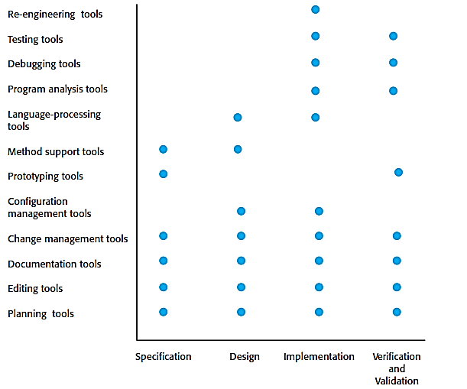
Activity Based Classification of CASE Tools

Slide 41
CASE Integration
Tools
Support individual process tasks such as design consistency checking, text editing, etc.
Workbenches
Support a process phase such as specification or design, Normally include a number of integrated tools.
Environments
Support all or a substantial part of an entire software process. Normally include several integrated workbenches.

Slide 42
CASE Integration

Slide 43

Thanks to All

